Slide 1
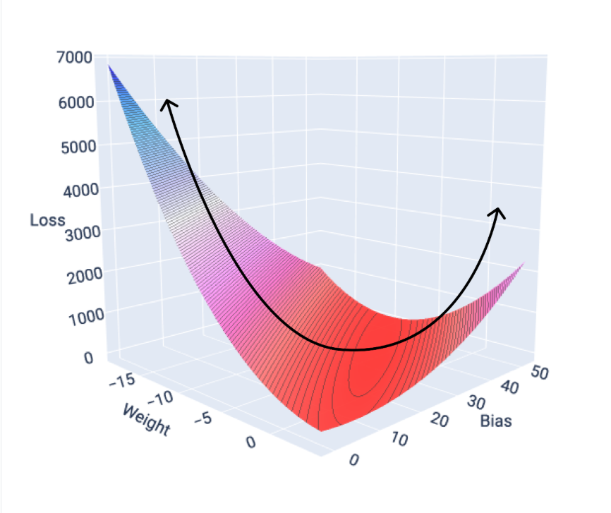

GRADIENT
DESCENT
A brief overview

Slide 2
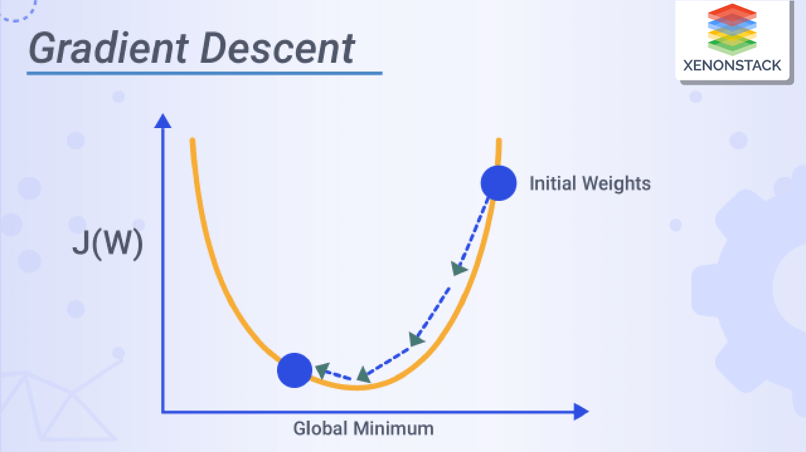
Agenda
What is gradient descent?
Types of Gradient descent
Terminology related to GD
Comparison of types of GD

Slide 3
Introduction

Slide 4

Our promise
Our approach is designed to deliver measurable results that significantly impact your business operations.
Save time
Streamline processes to maximize efficiency.
Cut costs
Optimize resources to reduce expenses.
Boost efficiency
Implement innovative solutions for better performance.

Slide 5
Quote
Your success is our strategy. Let’s make it a reality.

Slide 6
Understanding client needs

Slide 7
Challenges facing today’s clients
Many businesses struggle with inefficiencies:
- Outdated processes
- Increasing competition
- Adapting to technological changes
This hinders their ability to stay competitive in the market.

Slide 8
increased productivity with our unique workflow solutions
40%

Slide 9
The cost of inaction
Ignoring these challenges could mean lost revenue, slower growth, and declining customer trust:
Reduces operational efficiency and increased costs.
Increases difficulty in adapting to market changes and customer needs.
Limits innovation and stifles growth opportunities.
Addressing these issues promptly can help maintain a competitive edge and foster long-term success:
Enhances customer satisfaction and loyalty.
Improves overall business resilience and adaptability.
Strengthens brand reputation and market position.

Slide 10

How we help
Our team is dedicated to delivering customized strategies that align with your business goals and drive sustainable growth.

Slide 11
Pricing options & packages
Plan name | Features | Price | Best for
Basic | Core features, email support, single-user access | $399/month | Small businesses or startups
Pro | Advanced features, priority support, multi-user access | $599/month | Growing businesses needing scalability
Enterprise | Full suite of features, dedicated account manager, API access | Custom pricing | Large organizations with complex needs
Promotional offer | Get 20% off your first 3 months | - | New customers

Slide 12
COMPARISON OF TYPES OF GRADIENT DESCENTS

Slide 13
HOW DO THEY DIFFER FROM EACH OTHER?
Feature | Batch GD | SGD | Mini-Batch GD
Data per update | All data | 1 sample | Few samples
Speed | Slow | Fast | Moderate
Convergence path | Smooth | Noisy | Balanced
Memory usage | High | Low | Moderate
Use case | Small datasets | Very large datasets | Most practical ML models

Slide 14
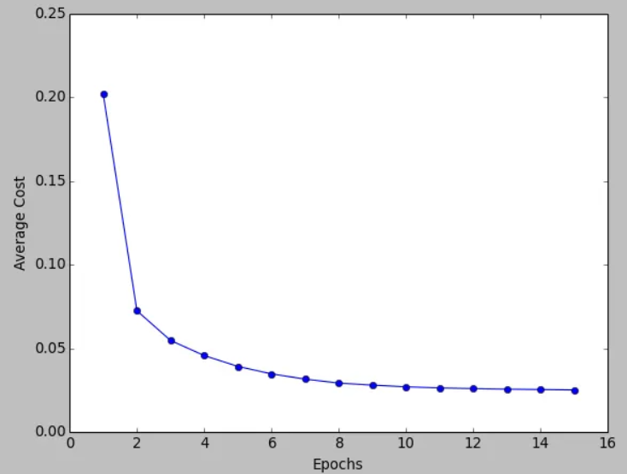
Quote
FULL BATCH GD
SMOOTH CURVE
GOOD FOR SMALLER DATASETS
OFFLINE TRAINING

Slide 15
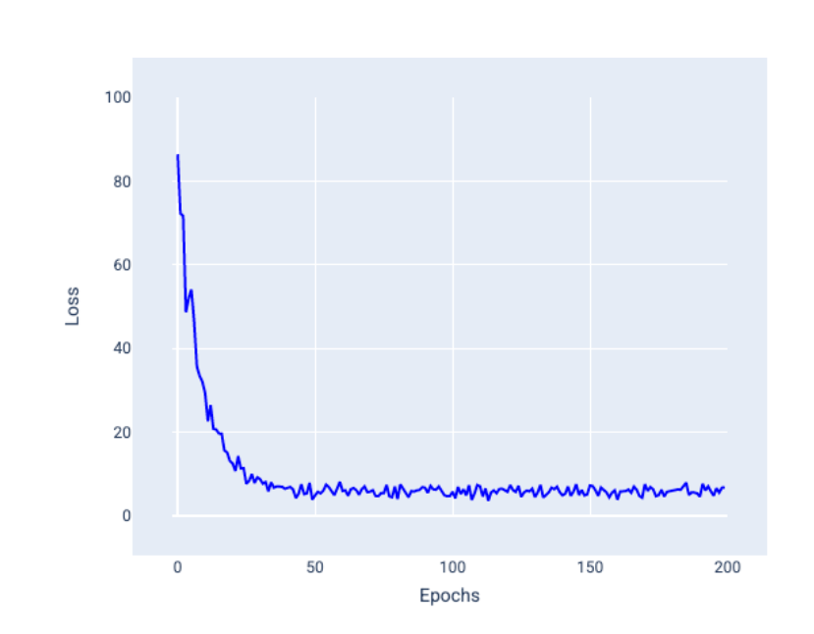
Quote
Stochastic gradient descent (SGD)
ZIG ZAG PATH
ONLINE LEARNING
STREAMING DATA

Slide 16
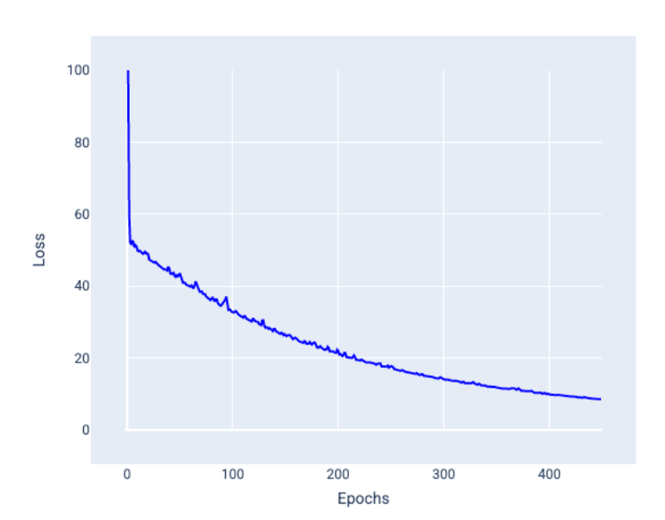
Quote
Mini-batch stochastic gradient descent (mini-batch SGD)
MODERATE FLUCTUATIONS
DEEP LEARNING
MOST WIDELY USED IN PRACTICE

Slide 17

Q & A
We will now open the floor for questions.

